Slide 1

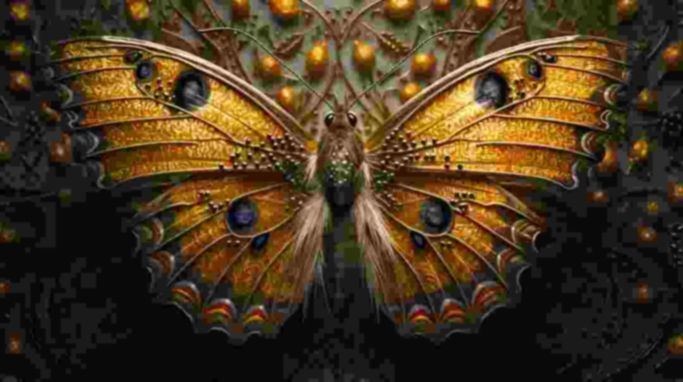
A MODEL THAT GENERATES NEW IMAGES
Enhancing Pre-trained Image Upscaling Models through Advanced Post-Processing Techniques
-Srinivas Makkena

Slide 2

Paper Citation:
Title: High-Resolution Image Synthesis with Latent Diffusion Models
Authors: Robin Rombach, Andreas Blattmann, Dominik Lorenz, Patrick Esser, Björn Ommer
Affiliation: Ludwig Maximilian University of Munich & IWR, Heidelberg University, Germany; Runway ML
Publication: arXiv preprint arXiv:2112.10752v2, 2022
Cited: 10322 times

Slide 3

Introduction:
Diffusion Models (LDMs) a novel approach to high-resolution image synthesis.
LDMs operate in a latent space –
Reducing computational costs.
Maintains or improves image fidelity compared to pixel-based diffusion models.
Motivation : High-resolution image synthesis by making it more computationally accessible, without sacrificing quality.

Slide 4

Related Works - Generative Models:
Generative Adversarial Networks (GANs):
Widely used for image synthesis with high perceptual quality
Require extensive training resources
Variational Autoencoders (VAEs):
Focus on density estimation. produce lower-quality images compared to GANs.
Autoregressive Models:
Autoregressive models excel in density estimation
Limited to low-resolution images due to computational complexity and sequential sampling

Slide 5
Related Works - Generative Models:
Diffusion Probabilistic Models (DMs):
Operate by gradually denoising a normally distributed variable, with UNet architectures.
Pixel-Based DMs:
Require substantial computational resources. time-consuming, expensive, hundreds of GPU days.

Slide 6

Methodology - Latent Diffusion Models:
Latent Space Representation:
Autoencoder compresses image data into a lower-dimensional latent space perceptually equivalent to original image space.
Diffusion Process in Latent Space:
Diffusion process applied in latent space
Cross-Attention Mechanism:
Flexible conditioning on inputs (text, bounding boxes, semantic maps).
Enhances high-resolution image generation with feature-specific guidance.

Slide 7
Methodology - Perceptual Compression & Sampling:
Perceptual Compression:
Autoencoder trained using combination of perceptual and adversarial losses.
Sampling Efficiency:
Reduced number of steps during sampling process compared to pixel-based diffusion.

Slide 8
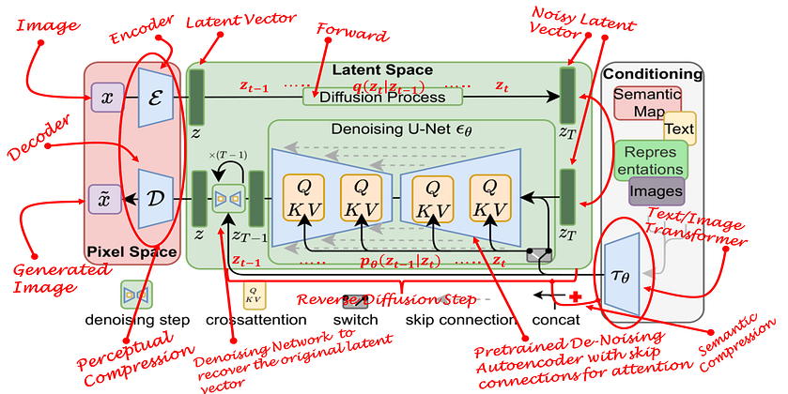
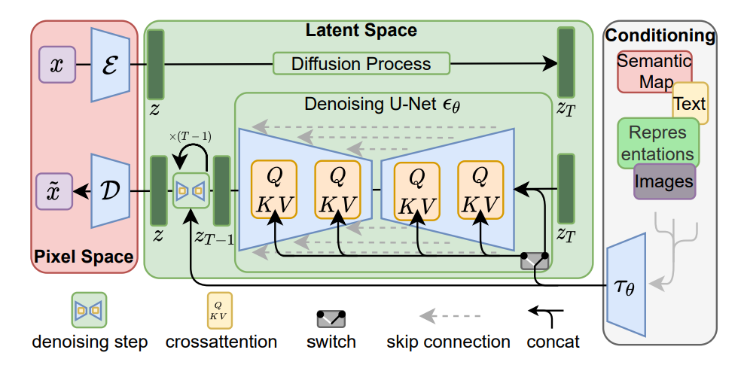
Methodology :

Slide 9
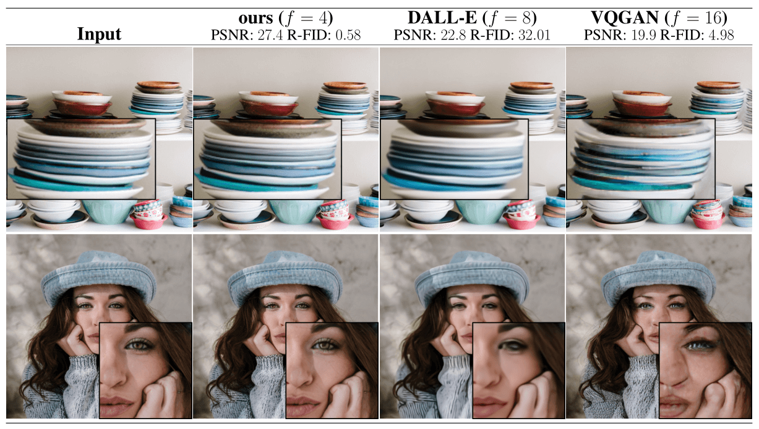
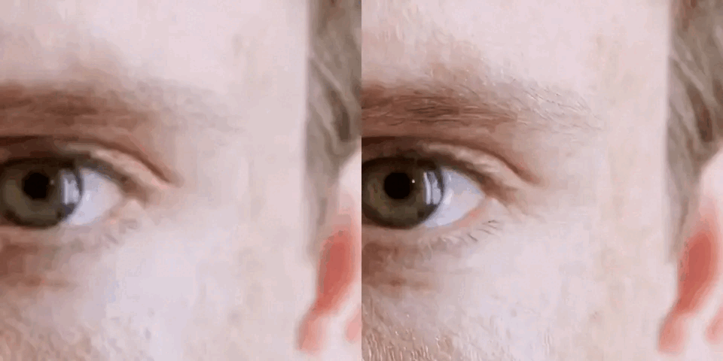
Results:
Image Generation with Latent Diffusion
Conditional Latent Diffusion
Super-Resolution with Latent Diffusion
Inpainting with Latent Diffusion

Slide 10

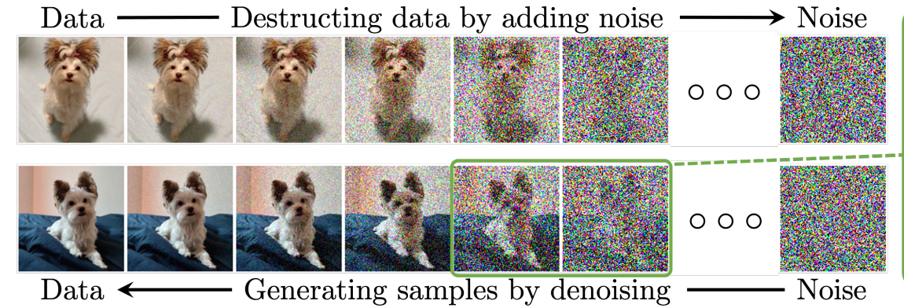
Conclusion:
Introduced Latent Diffusion Models (LDMs)
Achieved state-of-the-art performance with reduced computational costs.
Enhanced Flexibility and Accessibility
Integrated cross-attention, enabling broader application in image synthesis.
Significant Practical Applications
Applicable in areas like creative content generation and scientific imaging

Slide 11

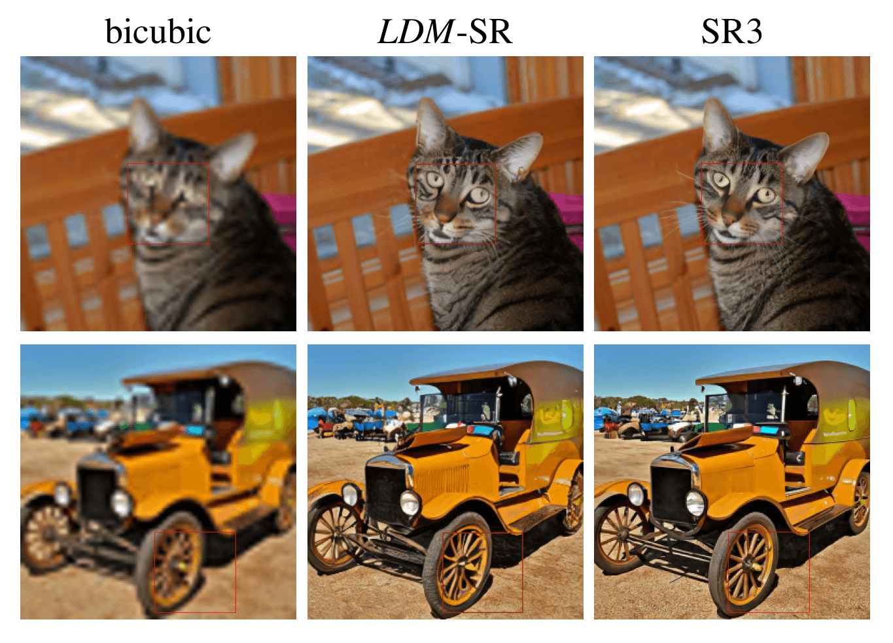
Future Work:
Enhancing Post-Processing Techniques.
Cross-Domain Upscaling
Learning from Noisy and Low-Quality Data
Interactive and User-Guided Upscaling
Optimization for Real-Time Applications

Slide 12



